Slide 1
Good Shepherd Primary & Nursery School Paired Reading

Slide 2
Why Paired Reading?
Paired reading is a simple but effective technique for helping all readers to increase their reading fluency and accuracy in text.

Slide 3
What are the advantages?
Increased enthusiasm: children are encouraged to pursue their own interests in reading material.
Lots of praise: pupils are told when they are doing well, instead of only errors being highlighted.
Emphasis of understanding: not just mechanically reading, but getting the meaning out of the words on the page.
No failure: it is impossible not to get a word right within 5 seconds or so. With paired reading it is easier for children to make sensible guesses at new words, based on the meaning of the surrounding words.
Children are encouraged to read with expression and the right pacing.
Children are given a perfect example of how to pronounce difficult words.
There is some evidence that just giving children more attention can actually improve their reading

Slide 4
Reading with a partner
PAIRED READING is a very good way for a parent to help with their children’s reading. It works well with most children and their reading gets a lot better.
Also, Paired Reading fits in very well with the teaching at school, so children don’t get mixed up. Most children really like it
– it helps them want to read.

Slide 5
WHAT YOU NEED
Books to choose from at home, from
school or the library. The child can also
choose newspapers, magazines, or other items they want to read.
Your child should choose the book. Children learn to read better from books they like. Don’t worry if it seems too hard. In Paired Reading you help the child through the hard bits. Your child will soon get used to picking books that aren’t too hard.

Slide 6
TIME
Try very hard to do some Paired Reading nearly every day, even if only for 5 minutes. Aim for 5 days per week. Don’t do more than 15 minutes unless your child wants to carry on. Don’t make children do Paired Reading when they really want to do something else.

Slide 7
You might not always have time
If parents haven’t got time to do Paired Reading 5 days a week, grandmother or grandfather or older brother or sister or even friends and neighbours can help.They must all do Paired Reading in just the same way, though, or the child will get mixed up.

Slide 8
PLACE
Try to find a place that’s quiet. Children can’t read when it’s noisy, or when there’s lots going on. Get away from the TV, or turn it off.
Try to find a place that’s comfy. If you’re not comfortable, you’ll both be shifting about. Then you won’t be able to look
at the book carefully
together.

Slide 9
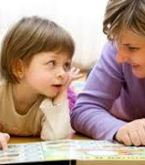
Get close
Reading together can be very warm and snuggly. You both need to be able to see the book easily.

Slide 10
NEW WAYS OF HELPING
When your child gets a word wrong, you just tell your child what that word says. You say the word right, then your child says it after you. You DON’T make the child struggle and struggle, or ‘break it up’ or ‘sound it out.’ Don’t worry if you come to a word neither of you are sure about – just look it up or ask someone.
BUT don’t jump in and put the word right straight away. Give the child 4 or 5 seconds to see if they will put it right themselves. However, if your child zooms straight past a mistake without noticing it, you may have to point out the mistake a bit quicker.

Slide 11
And…...
Praise
good reading of hard words,
getting all the words in a sentence right
putting wrong words right before you help (self correction)

Slide 12
Pointing at words. The answer is “yes” or “no”.
On a hard book, or when the child is tired or not concentrating well, pointing might help. But only do it when necessary, not all the time. And if the child can do it rather than you, that is better. Sometimes both can point together.

Slide 13
Paired Reading Diary
Note down the date, what was read, for how long, who helped and any
comments about how well the child did. This can be taken into school each week by the child to show the teacher – who will give more praise and write their own comment.

Slide 14
HOW TO DO IT
To start with, especially when reading something which is hard for your child, you and your child both read the words out loud together. You must not go too fast. Make your speed the same as your child’s. This helps the child through the hard bits and gives a good example of how to read well. Your child must read every word. If your child struggles and then gets it right, show you are pleased. But if your child hasn’t said the word right in 4-5 seconds, just say it right yourself again, then let the child say it right as well, then carry on. If your child rushes past mistakes, you might have to put them right a bit quicker.

Slide 15
And….
Make sure your child looks at the words. Especially on hard reading, it can help if one of you points to the word you are both reading with a finger. It’s best if your child will do the pointing.

Slide 16
Reading Alone
When you are Reading Together and your child feels good enough, he or she might want to read a bit alone. You should agree on a way for your child to signal for you to stop Reading Together.
This could be a knock, a sign or a squeeze. Some children like to nudge you. The signal must be clear, easy to do and agreed between you before you start. (You don’t want your child to have to say “be quiet”, or they will lose track of the reading).

Slide 17
Taking turns
When the child signals, you stop reading out loud straight away, and praise the child for being confident.
When Reading Alone, sooner or later your child will struggle for more than 5 seconds, or struggle and get it wrong. Then you read the word out loud right for your child and make sure your child says it right as well.
Then you both go on reading out loud Together again, to get back into a flow. Soon your child will again feel good enough to read alone and signal you to be quiet. You will go on like this, switching from Reading Together to Reading Alone to give the child just as much help as they need.
You will Read Together more on hard books, less on easy books.

Slide 18
Be clear with your child
Try to make sure you stick to these “Rules”, at least for the first few weeks. If you don’t you may get in a muddle. Make sure you don’t do each other’s “job”.
The child signals you to stop reading aloud – don’t decide to go quiet when you feel like it. Also, when the child makes a mistake Reading Alone, you must correct it and go back to Reading Together. The child might ask for you only to give them the word they got stuck on – but that’s not what the Rules say!

Slide 19
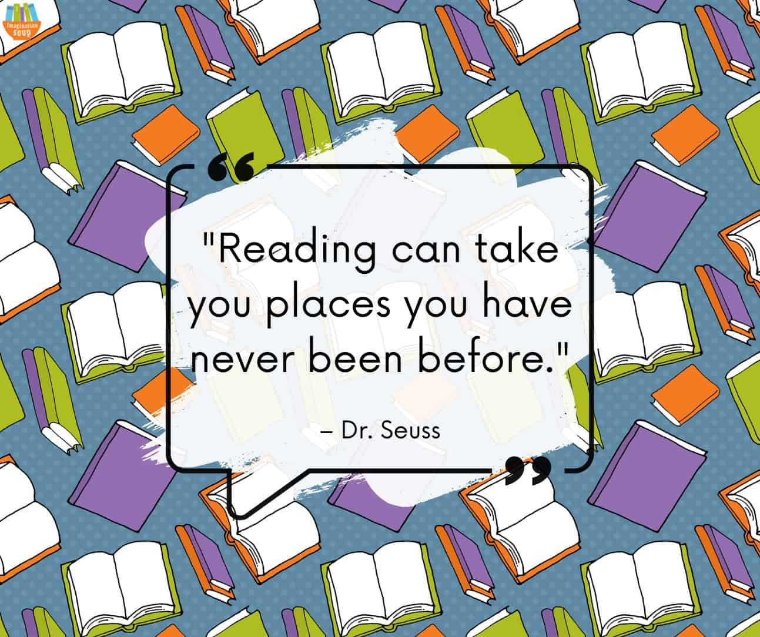
Enjoy this special time with your child
https://www.google.co.uk/search?q=paired%20reading%20site%3Ayoutube.com&safe=active&ved=2ahUKEwiug46G3oeEAxU4WkEAHdo2D7oQ2wF6BAgMEAE&ei=Yku6Za7KDbi0hbIP2u280As#fpstate=ive&vld=cid:ff6fc02b,vid:RJmXBQ59sxE,st:0

