Slide 1
Notes:
Please customise, add or remove slides and information to reflect how the Summer Reading Challenge is run locally.

Slide 2
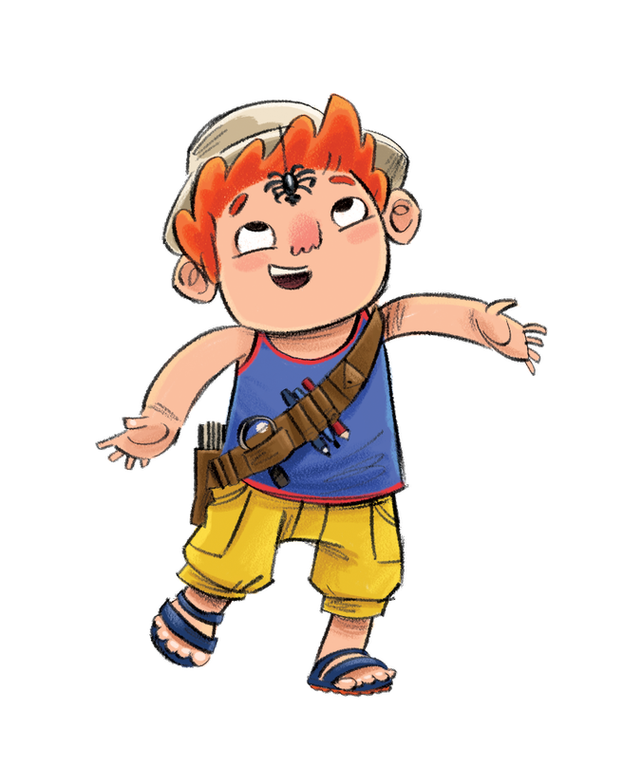
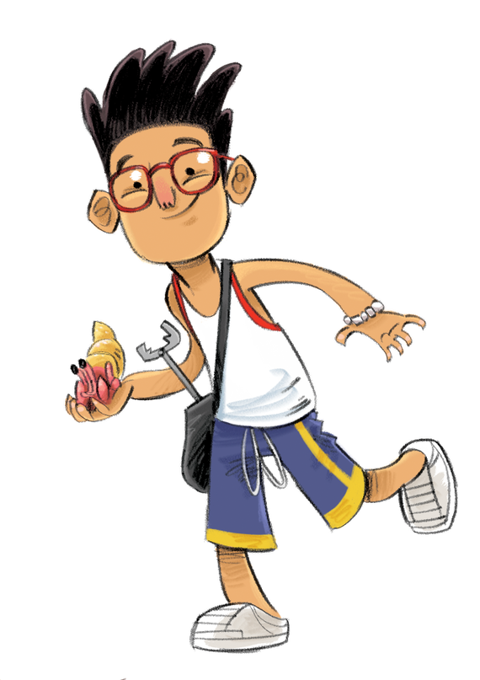
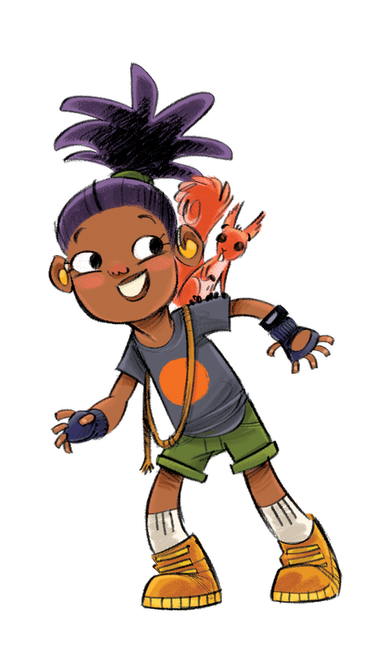
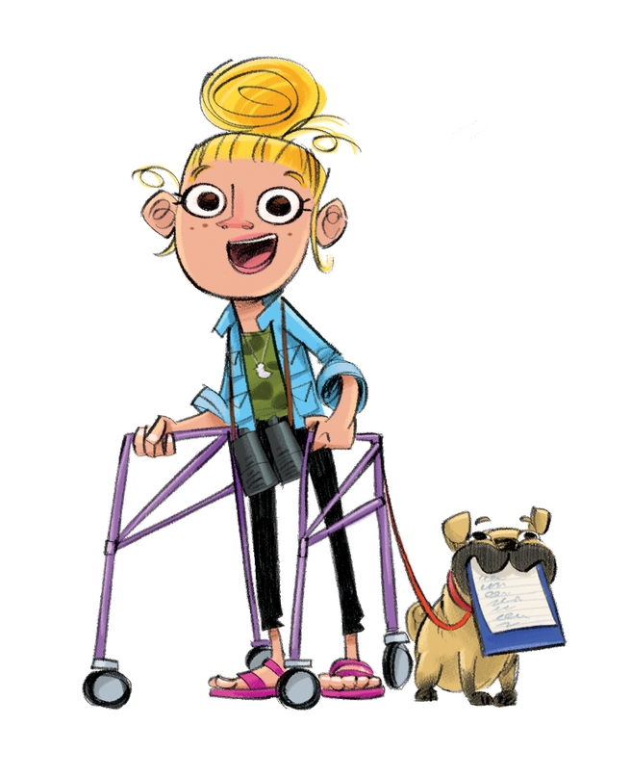
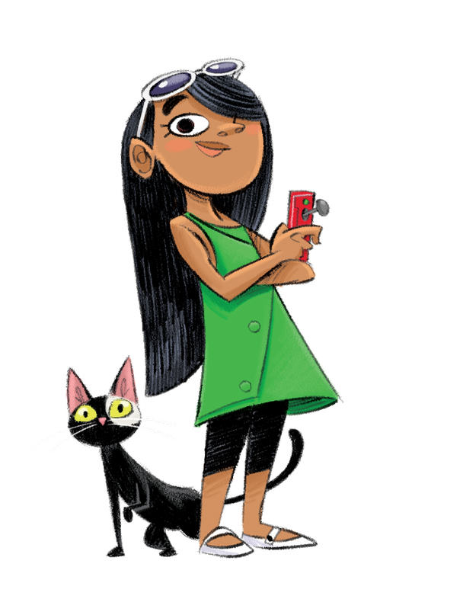
Notes:
Meet the Wild World Heroes! David, Willow, Marcus, Faiza, Carys and Callum.
The Heroes all live in Wilderville. It’s a pretty cool place, but recently the Heroes have noticed a few problems. Our Heroes need your help to fix them and to make Wilderville the best place to live for humans and animals.

Slide 3
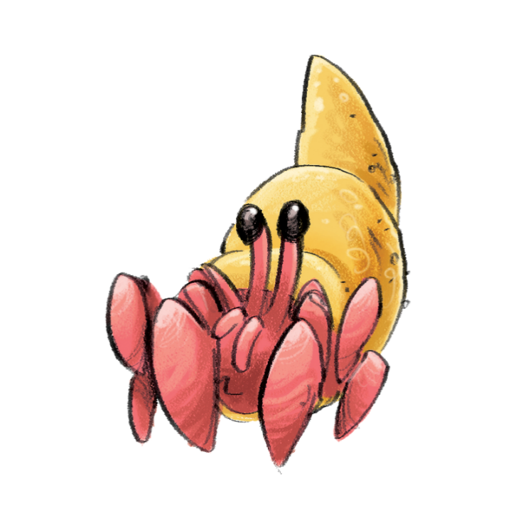
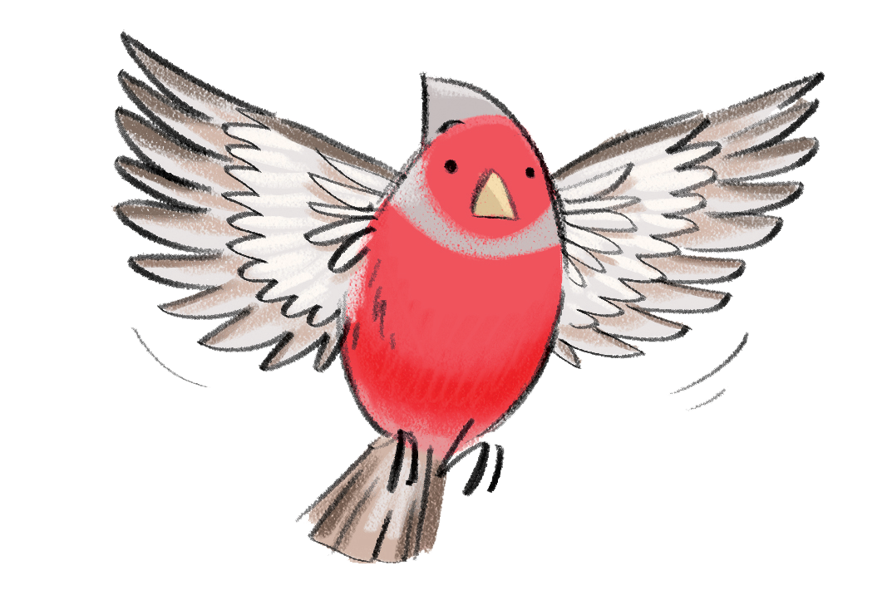
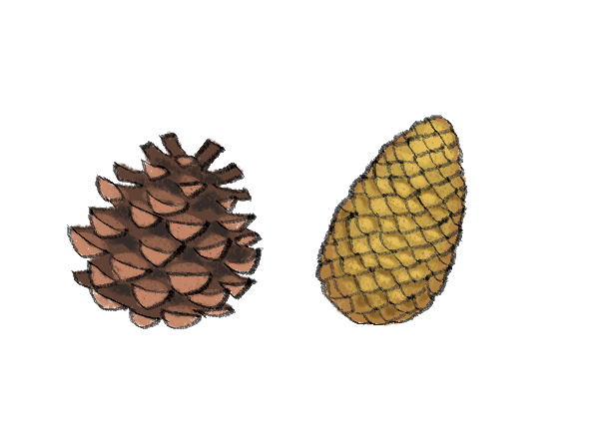
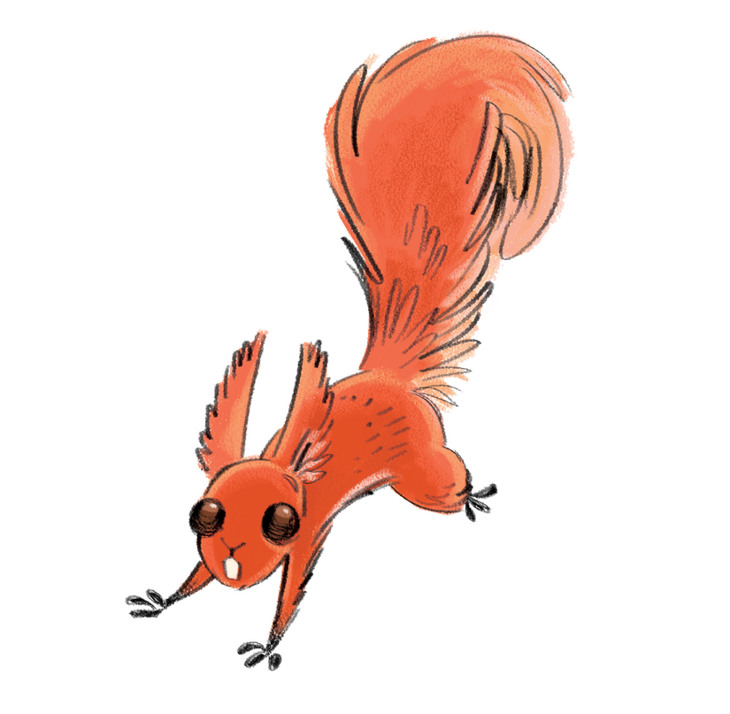
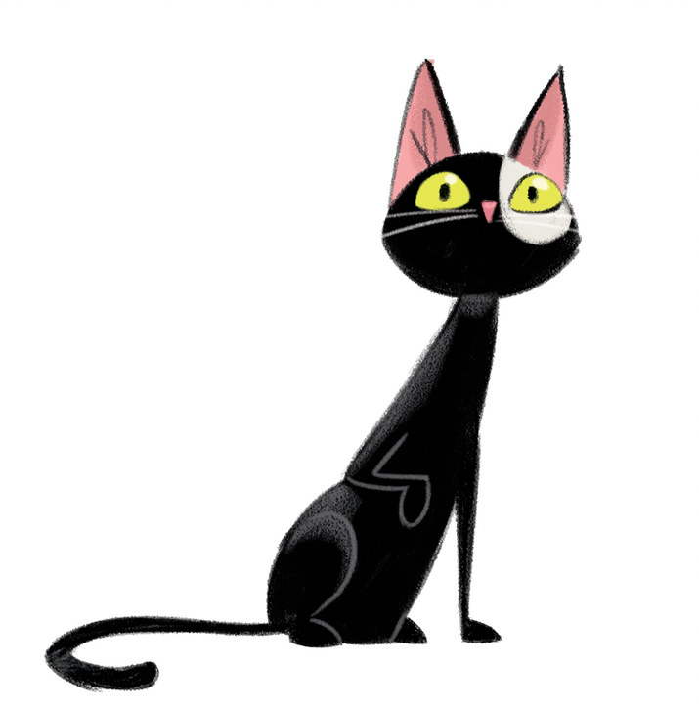
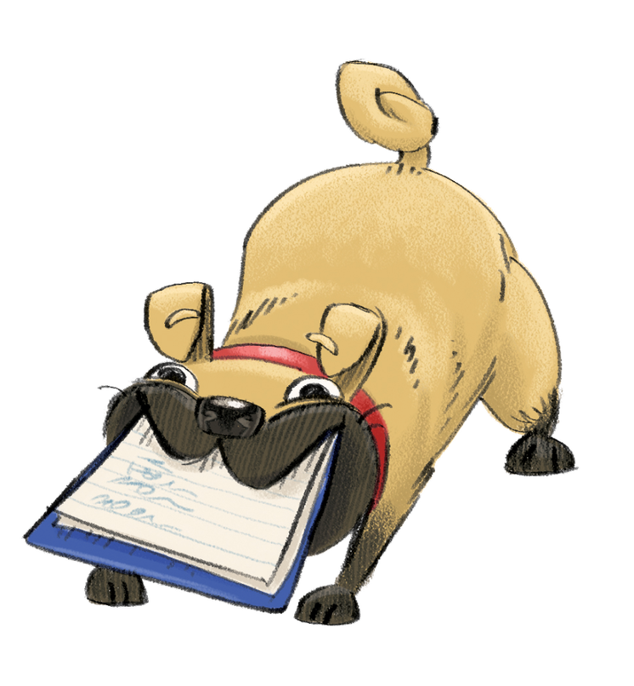
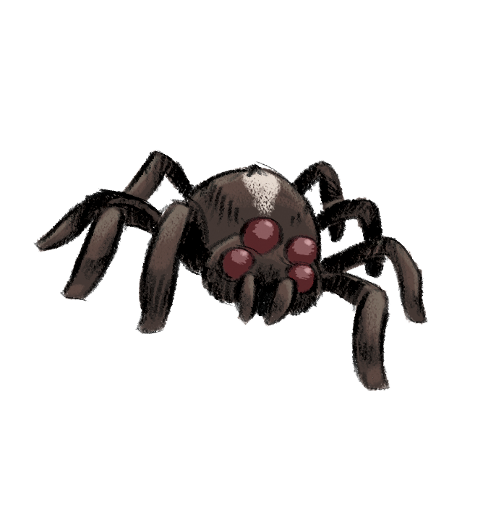
Notes:
All the Heroes know that we share our world with a whole host of wonderful creatures. Here are their animal companions: Charlie the Chaffinch, Shelby the Crab, Hazel the Red Squirrel, Doug the Dog, Webster the Spider and Mouse the Cat!

Slide 4
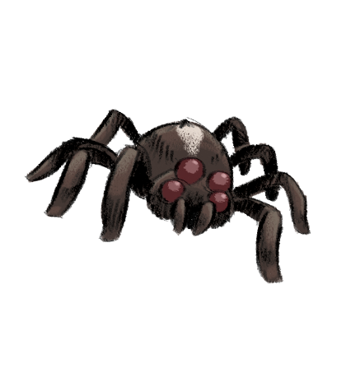
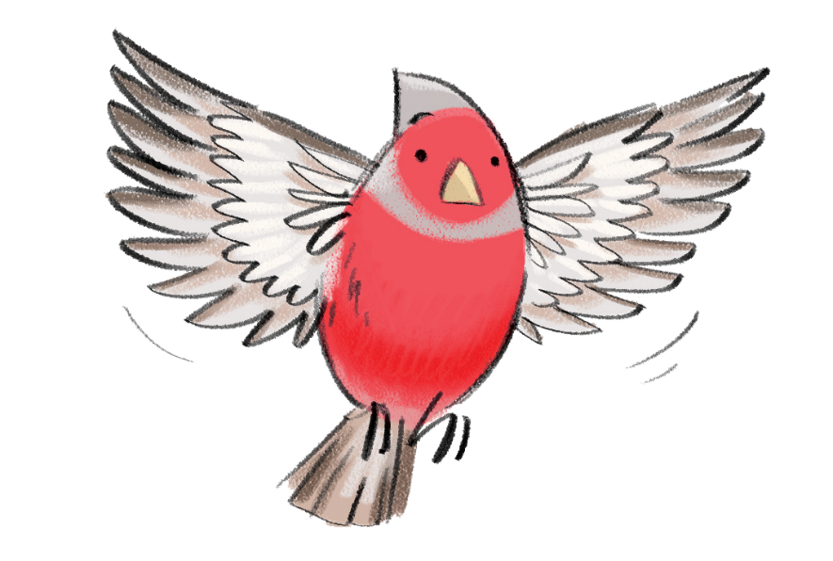
Notes:
When you join the Summer Reading Challenge at the library, you’ll receive your very own collector poster featuring a map of Wilderville. ​
​
You’ll get to explore lots of different locations and habitats. Join the Heroes for a walk through the woods, visit the beach, or hang out in the town. What wildlife do you think you will find?
Become a Wild World Hero and discover how YOU can make a difference to the place you live.
Each time you read a library book for the Challenge, you’ll get one step closer to fixing the environmental problems in Wilderville and will help make it a better, greener place to live!

Slide 5
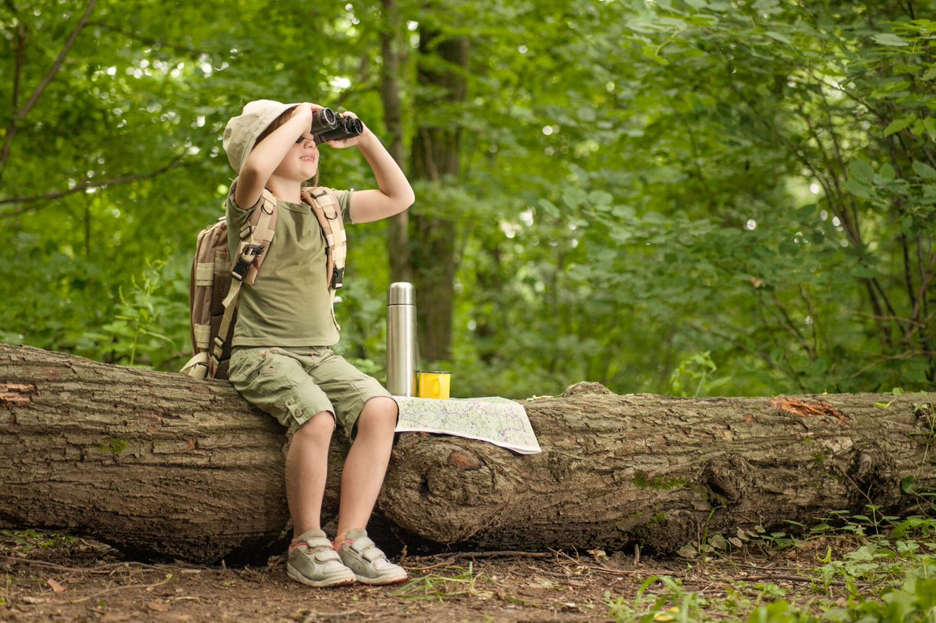
Go to your library this summer to join the Challenge – IT’S FREE!
Sign up to receive your special Wild World Heroes collector poster
Choose books to read over the holidays
Collect stickers for each book you read
Add the stickers to your poster to complete the Challenge and become a Wild World Hero!

Slide 6
Complete the Challenge and you’ll get your own certificate
Notes:
Most library authorities will also give medals to children who complete the Challenge, but not all. Please check with your local library service. ​

Slide 7
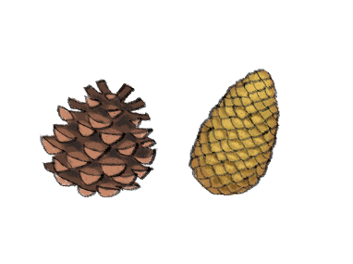
Take part this summer
Waterside Library Glendermott Road BT47 6BG
Monday to Saturdays 10.00am to 5.00pm
Monday 28th June
Saturday 4th September
Notes:
Are you ready to become a Wild World Hero?
Customise this slide with your own library information.

Slide 8
Visit the website
wildworldheroes.org.uk
Set your own summer reading goal
Rate and review your books to unlock badges
Play games and enter competitions
Enter the codes printed on your stickers to unlock extra rewards
Use the Book Sorter to find books recommended by other children
Notes:
The fun continues at home too! Visit the Wild World Heroes website to play games, review your latest reads and enter competitions to win amazing Summer Reading Challenge prizes. You can share your favourite books with other children taking part in the Challenge and even unlock extra rewards for your reading.

Slide 9
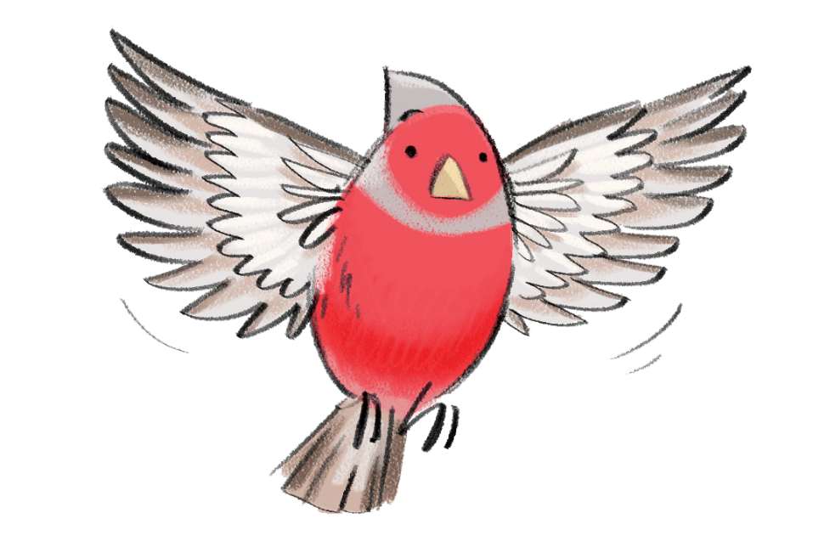
See you at the library!

